Slide 1


Connecting Kids to Justice -- Day One

Slide 2

One way that we show others that God is a friend who is real is by helping them. This week, we have a chance to help people from all over the world.

Slide 3
Catholic Social Teaching
Catholic Social Teaching tells us we are all one human family, and we must put the needs of the poor and vulnerable first.
“…‘Come, you that are blessed by my Father, inherit the kingdom prepared for you from the foundation of the world; for I was hungry and you gave me food, I was thirsty and you gave me something to drink, I was a stranger and you welcomed me…”
-- Matthew: 25: 34-35

Slide 4
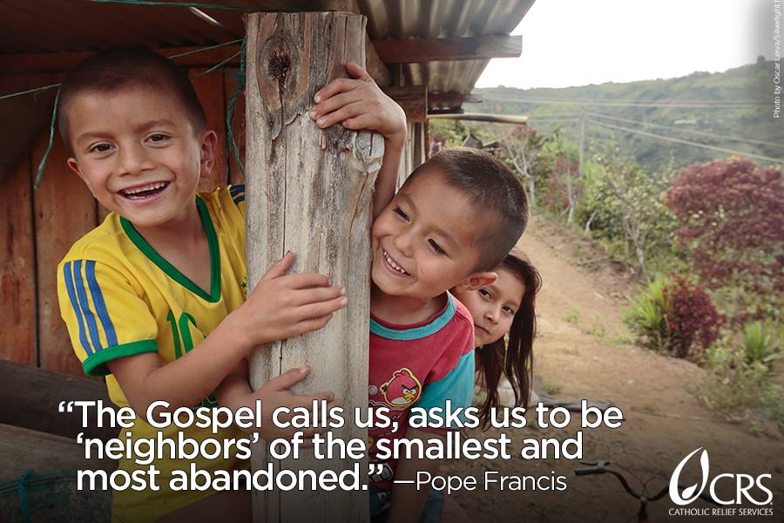

Slide 5
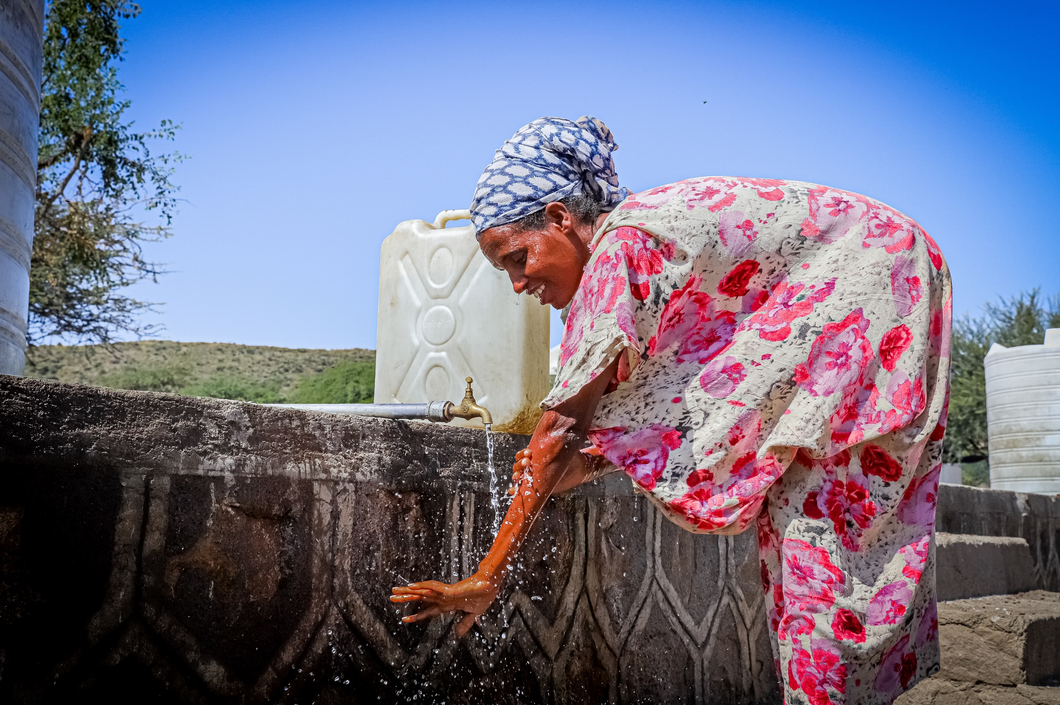

Slide 6
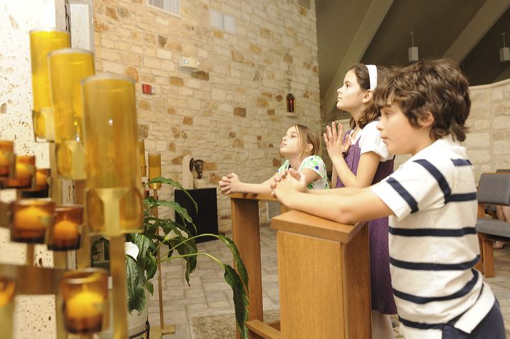
One important thing we can do is pray for our human family, especially the poor and vulnerable who need our help.

Slide 7
Prayer for Our Human Family
God, Father of us all,
thank you for our families.
Help us to take good care of
everyone in our human family.
Keep all of us safe today and every day.
Amen.

Slide 8
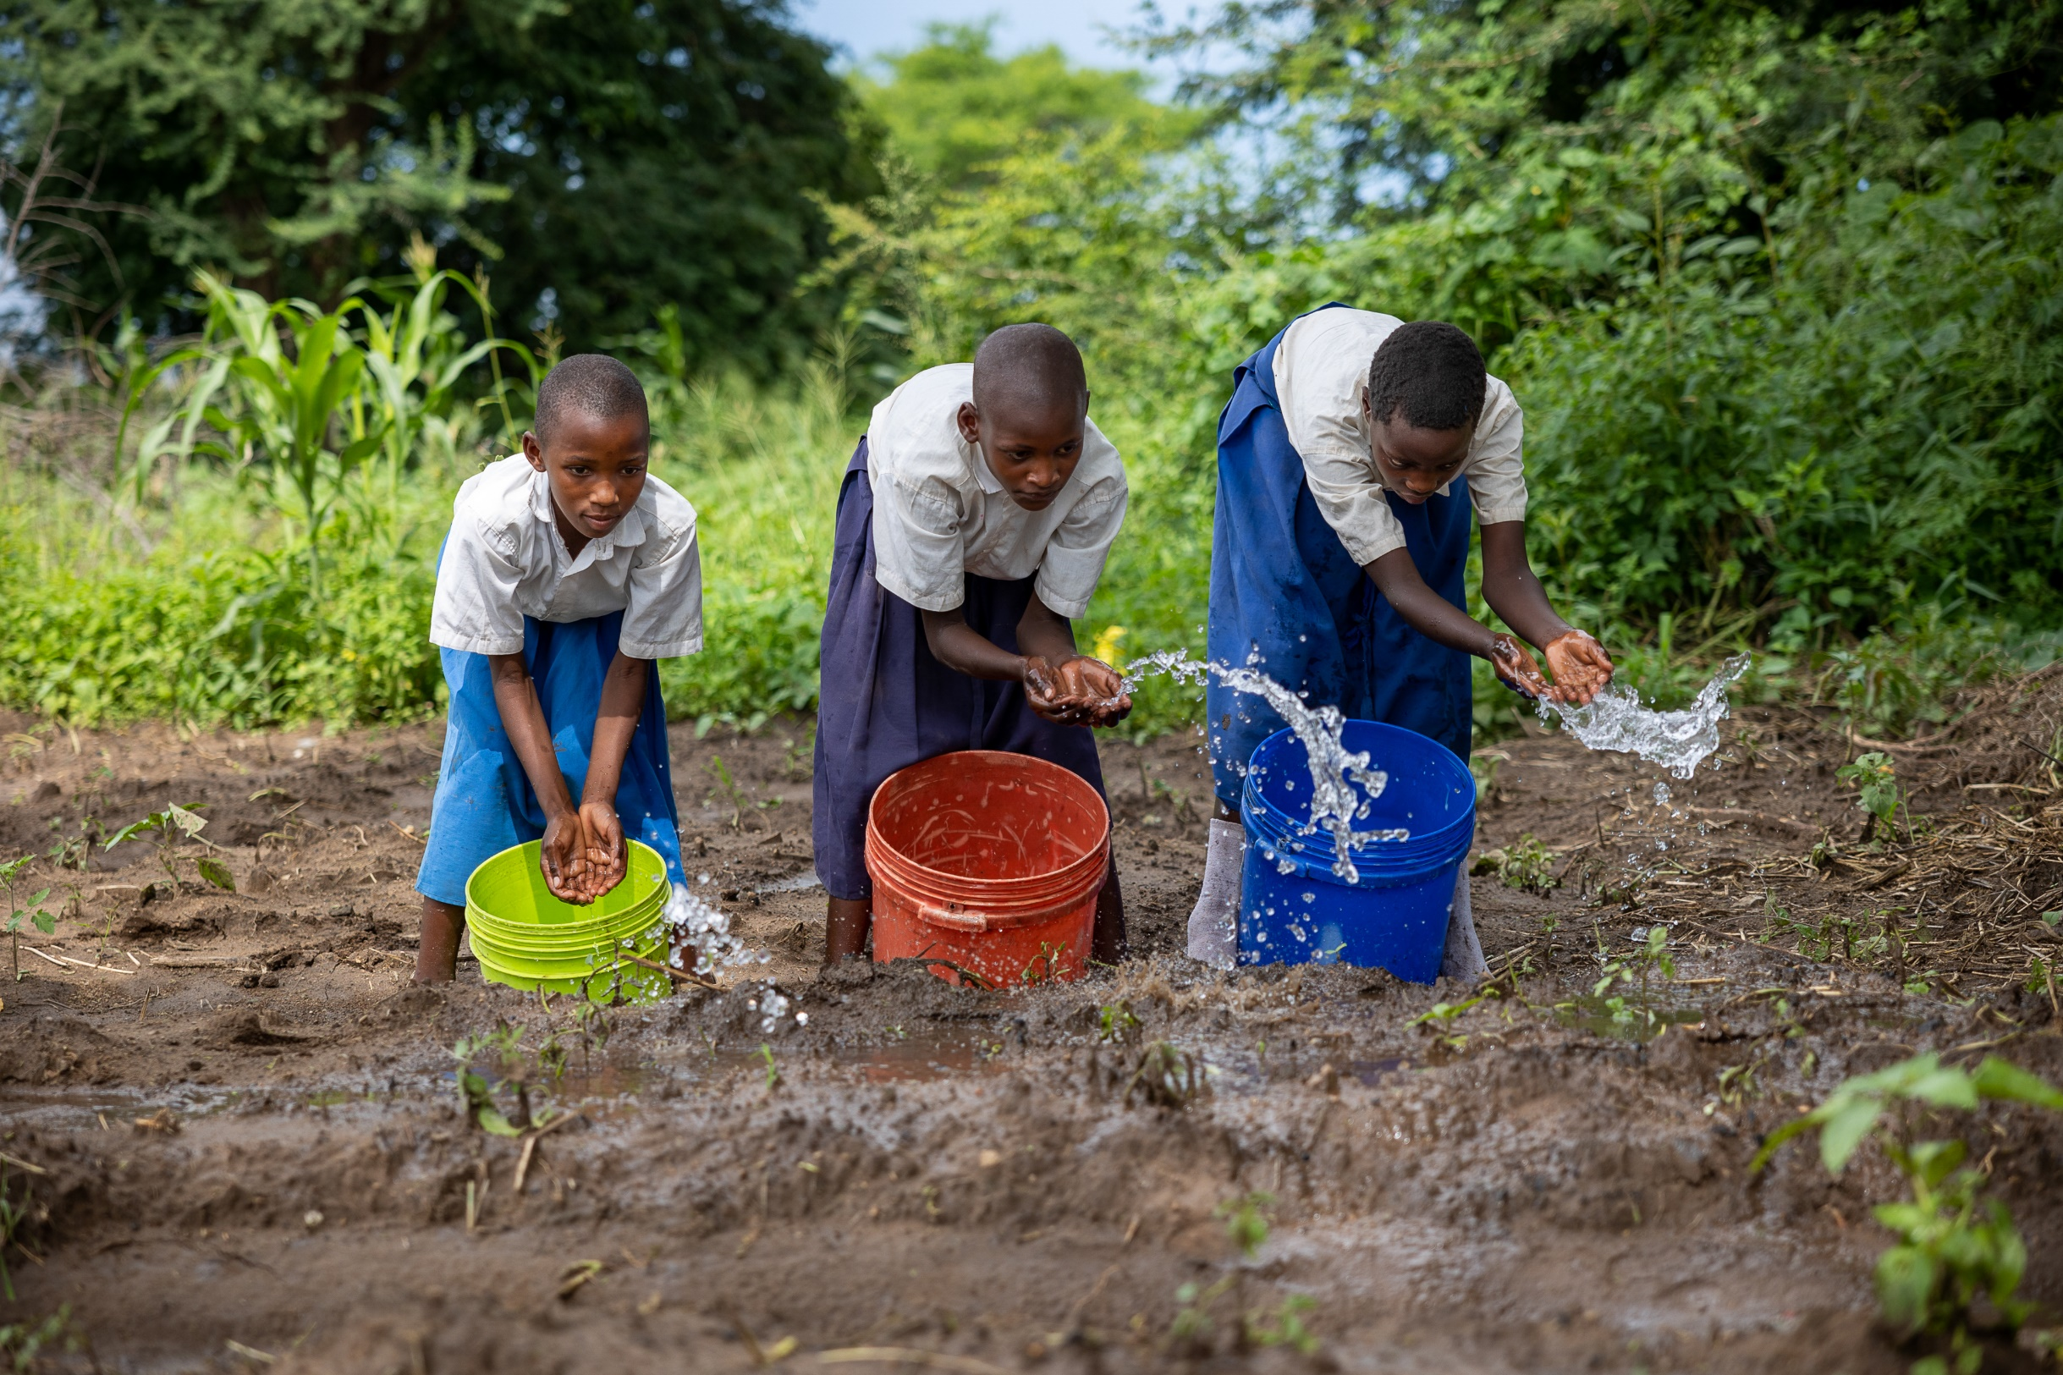
Talk About It
Do you have chores you do to help your family? What are they?
What can you and your family do to help the poor and vulnerable?

