Slide 1
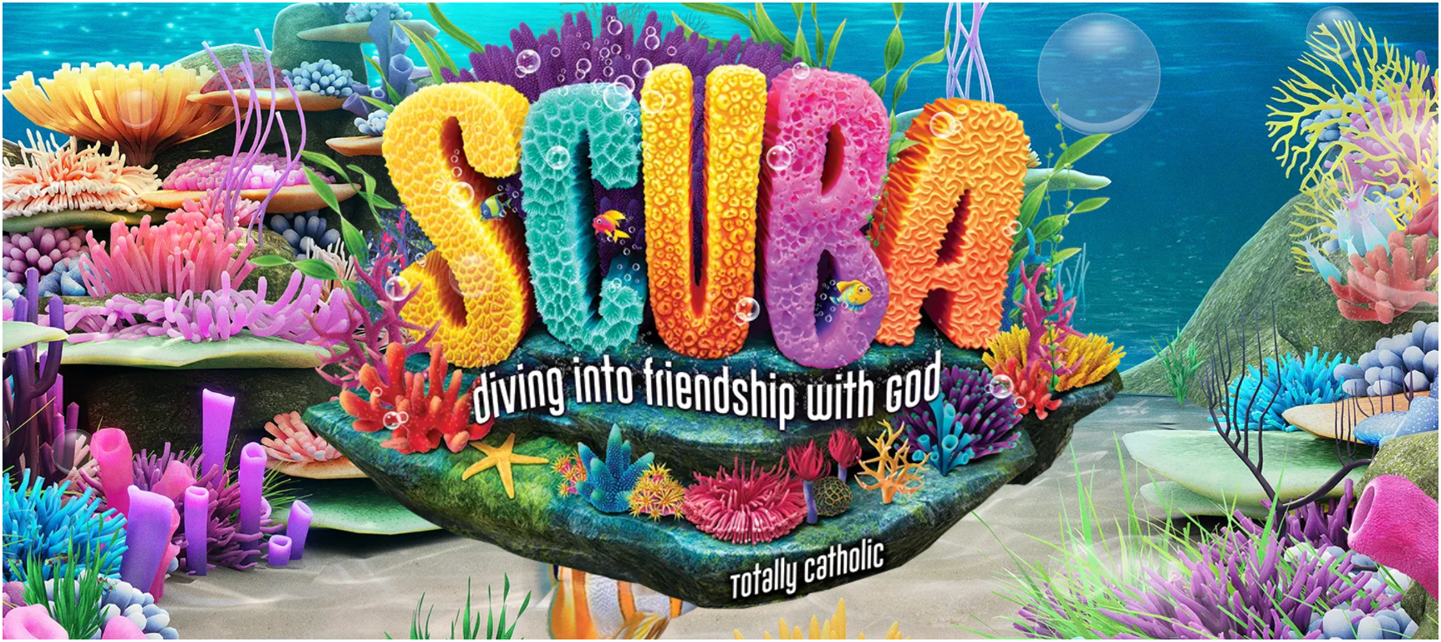

Connecting Kids to Justice -- Day Two

Slide 2

God is a friend who loves.
And we can show his love to others in their time of need.

Slide 3
Catholic Social Teaching
As Catholics, we know that every human deserves kindness and respect.
Jesus said, “Just as I have loved you, you also should love one another” (John 13:34).

Slide 4
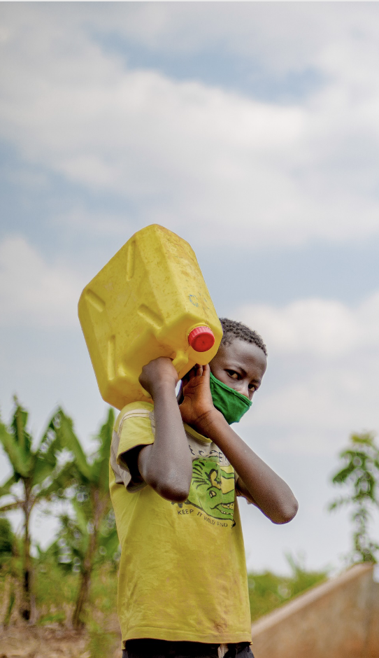
All humans need clean water to stay healthy and live full lives. This isn’t always easy, especially for people who live in remote or desert places.

Slide 5
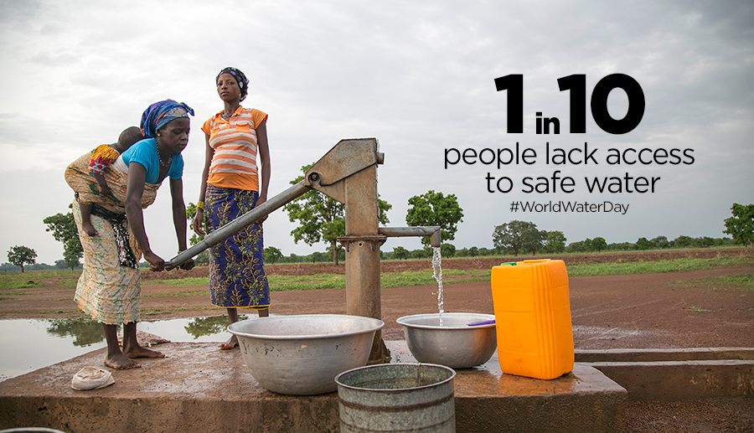

Slide 6
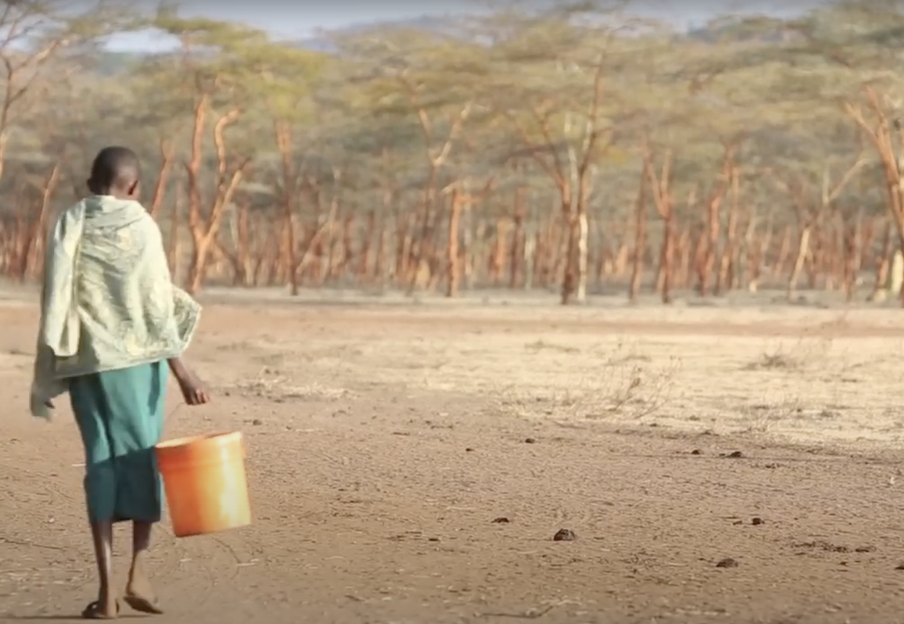
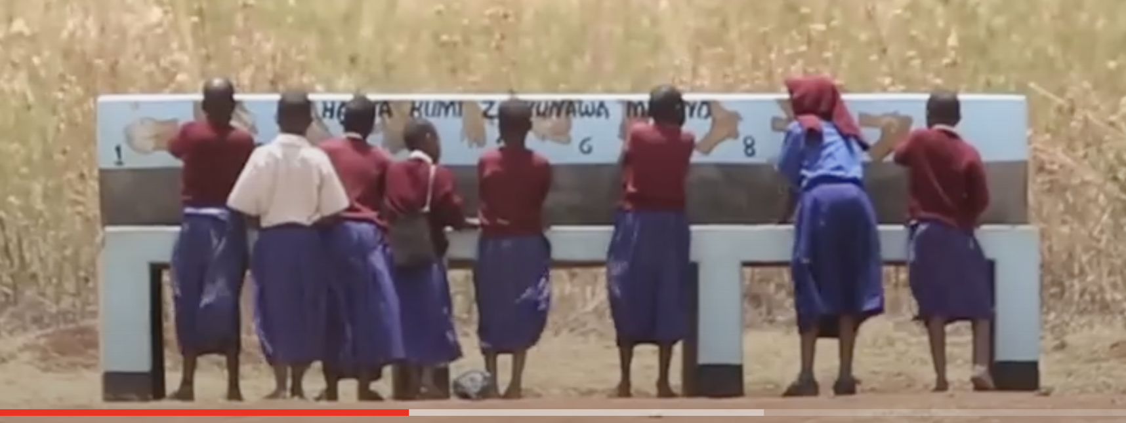

Slide 7
Catholic Relief Services
One way we can help people who need water is by raising money for organizations like Catholic Relief Services (CRS). CRS helps communities dig new wells and teaches them how to keep their water clean.

Slide 8
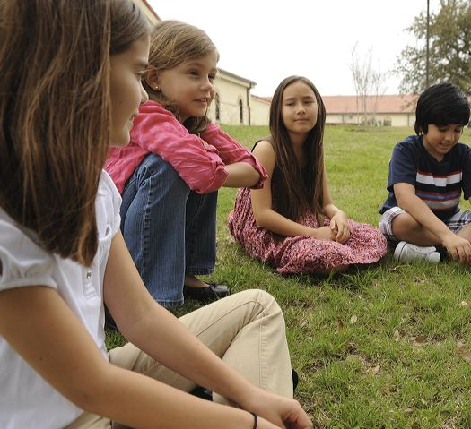
Talk About It
How do you show respect and care to others in your community?
Why is it so important to wash your hands with soap?

