Slide 1
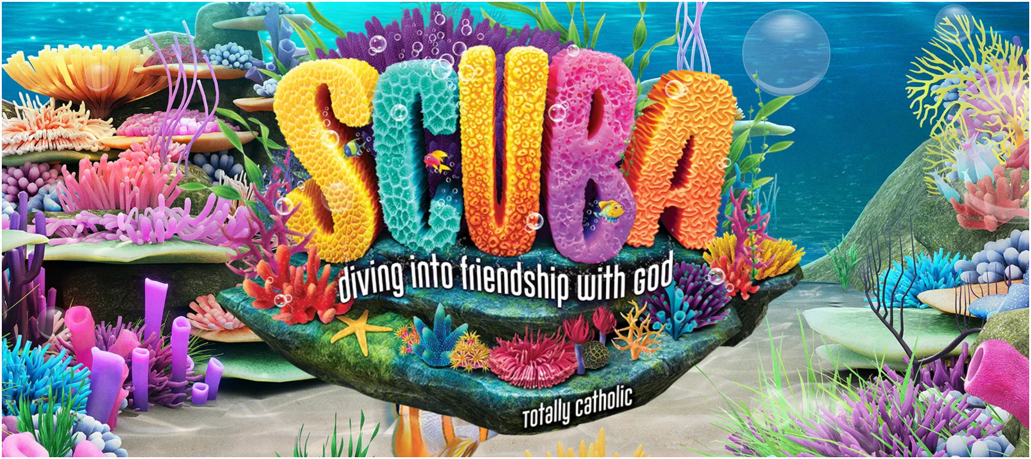

Connecting Kids to Justice -- Day Three

Slide 2
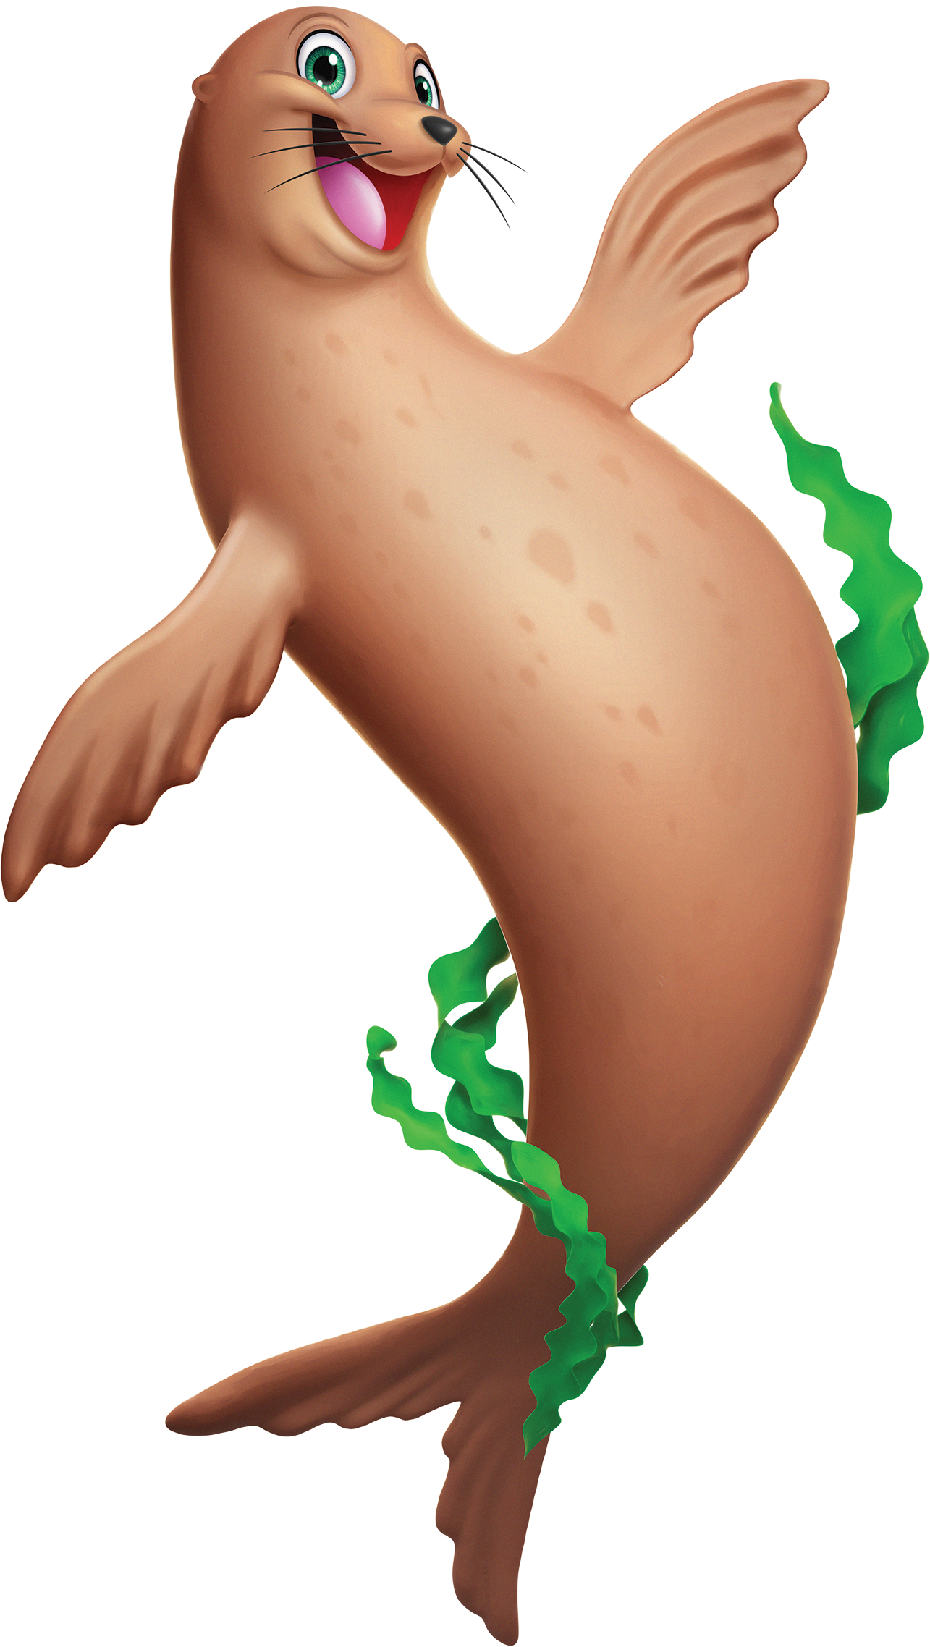
How many of you have had a drink of water today?
Who has taken a bath or washed their hands today?
How did you get your water?

Slide 3
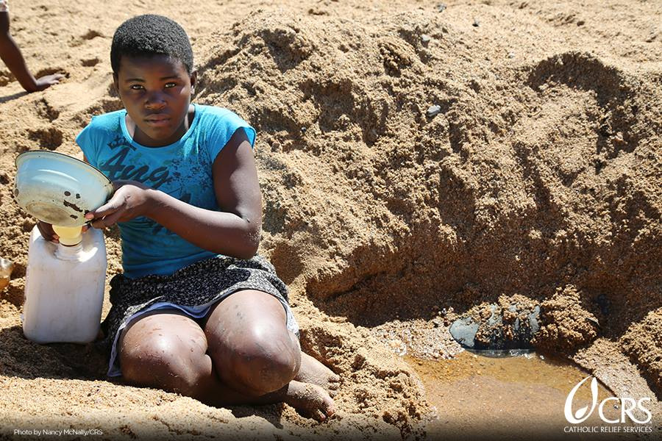
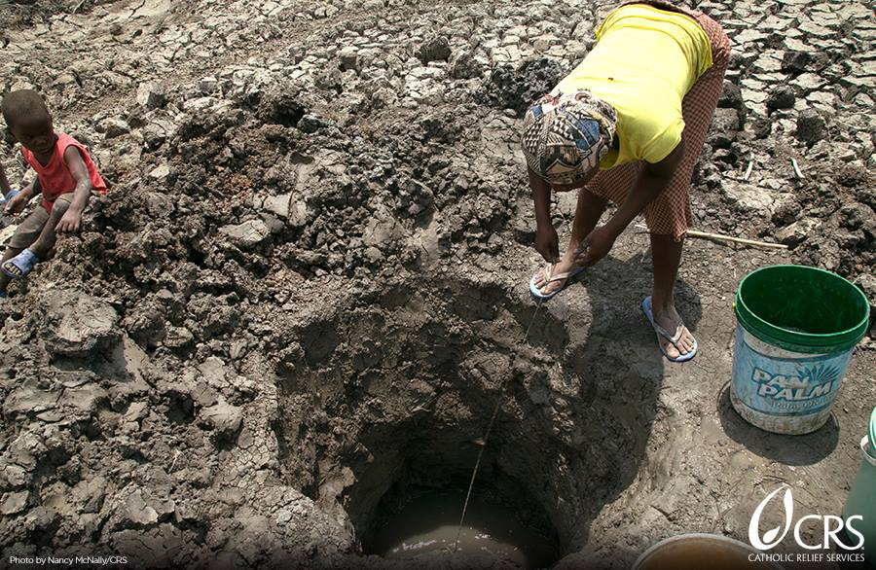
For some communities in our world, getting clean water is a lot of work.
It doesn’t flow from a faucet or fountain, like the water you drank or washed with today.
We’ve also learned that in some places, water is scarce and sometimes dirty.

Slide 4
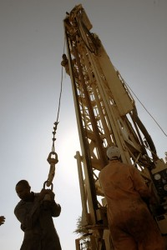
Turn on the Water!
The money you are bringing this week will help organizations like CRS make clean water flow!
CRS works with communities to dig new wells or build pumps to bring clean water to families!

Slide 5
Catholic Social Teaching
Every person has a right to life. Having clean water that is easy to get and always available helps children all over the world to live healthier, better lives. God is a friend we can trust. He has created enough resources for everyone on earth to have what they need to live, but God calls us to be his hands and feet to get resources like clean water to people who need them. We have a responsibility to share the gifts God has given us with others.

Slide 6
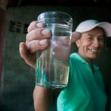
Talk About It
What does Jesus say about helping other people?
How do we really show our love for other people?

