Slide 1


Connecting Kids to Justice -- Day Five

Slide 2
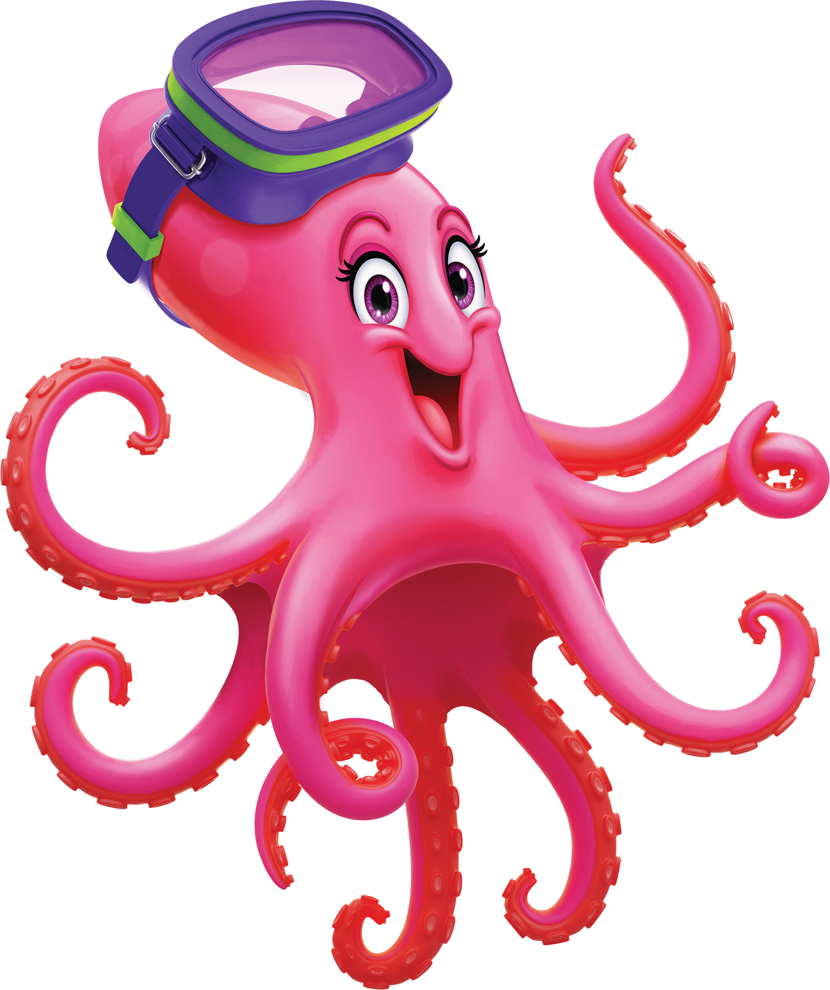
Our last day together at Scuba VBS!
It’s been a “splashtastic” week filled with great music, friends and fun!

Slide 3
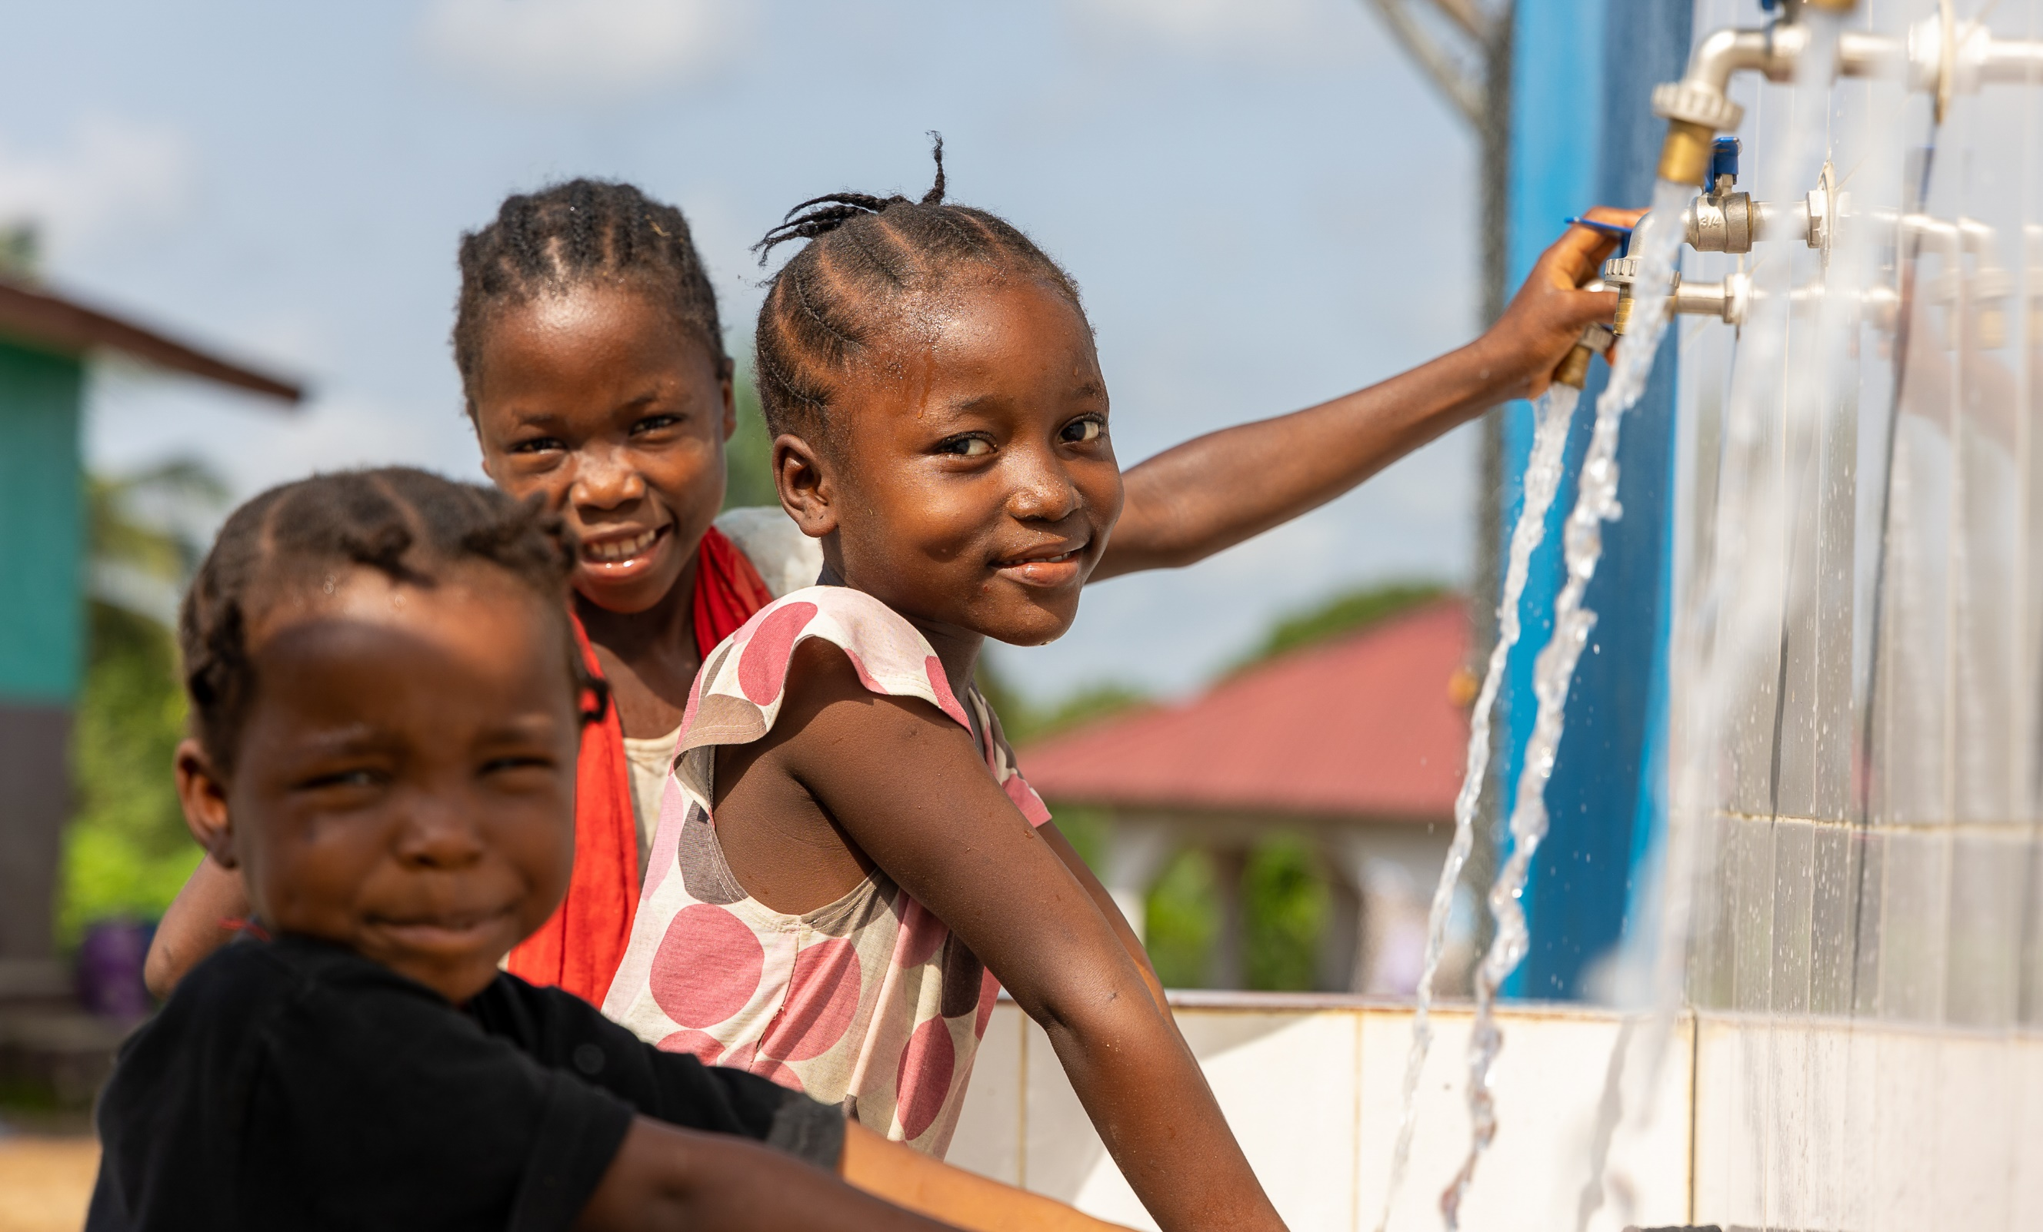
Flowing Water
Are you excited about the money you have collected? Your money will support families just like yours--providing them with clean water so their children can grow up to be happy, healthy and loving.

Slide 4
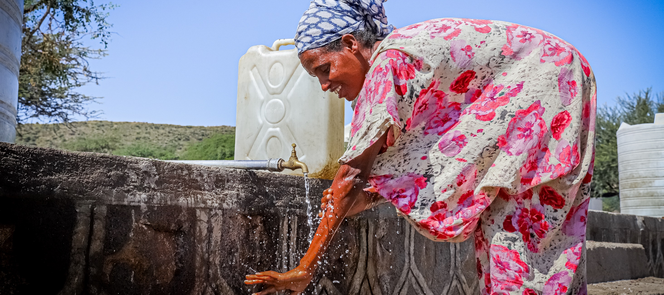
Let the clean water flow!

Slide 5
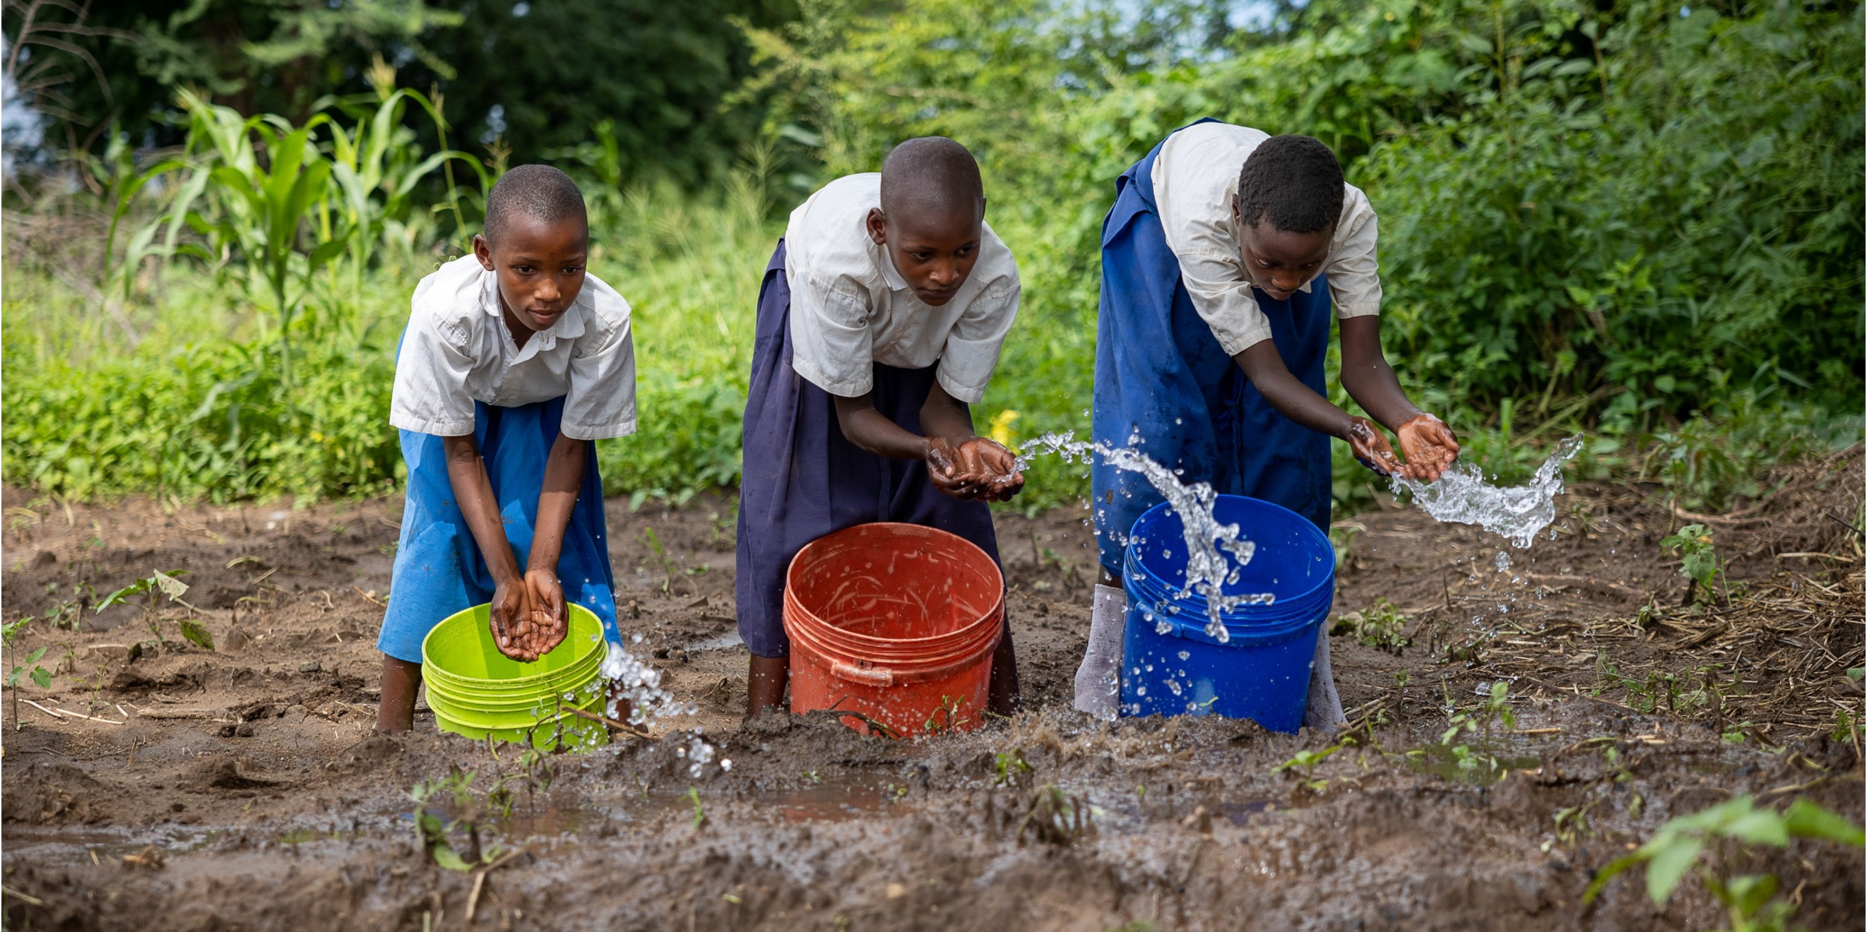
Catholic Social Teaching
As Catholics, we know that we are all one human family, here to help each other.
God is a friend for everyone!

Slide 6
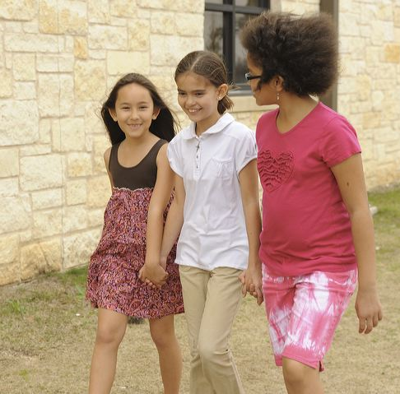
Talk About It
How can we continue to help people and share God’s goodness after VBS?
Do any of you have any good ideas to share?

Slide 7
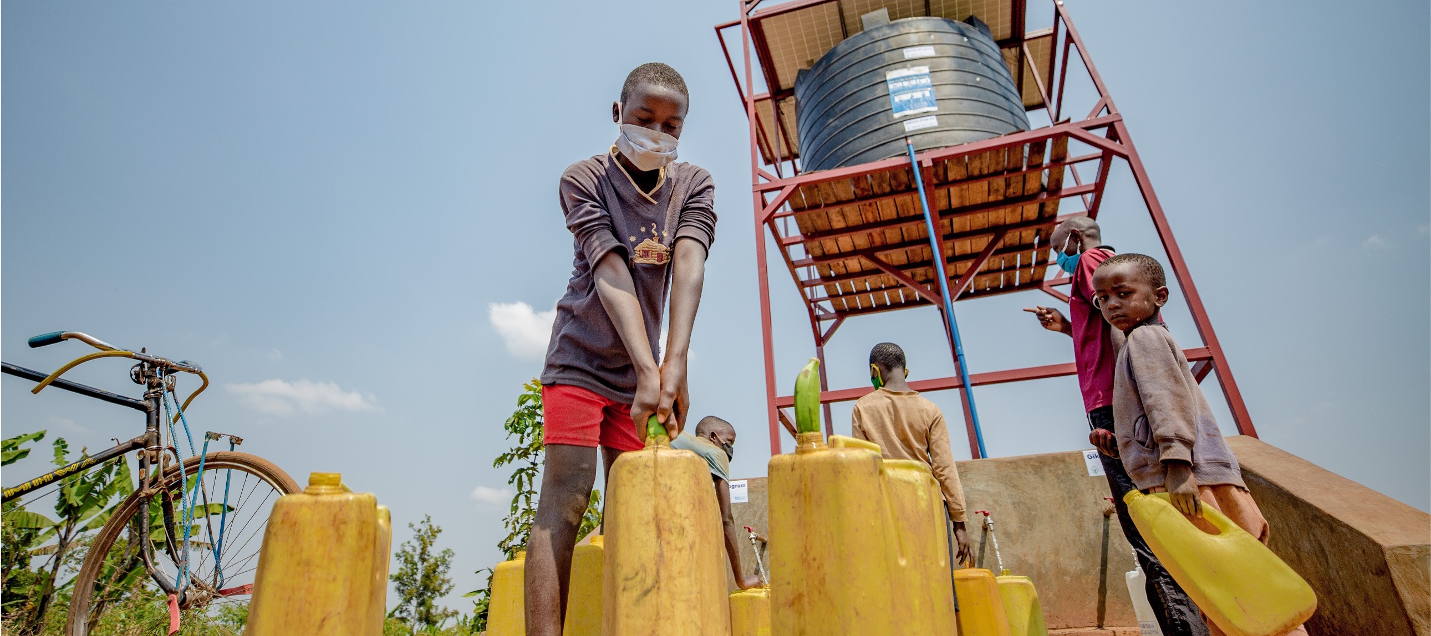
It’s been a wonderful week at Scuba VBS.
Thank you for making a difference!

